Slide 1
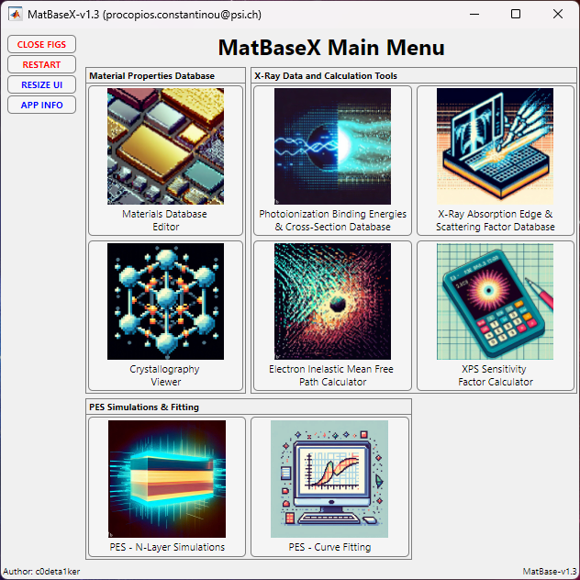

Slide 2
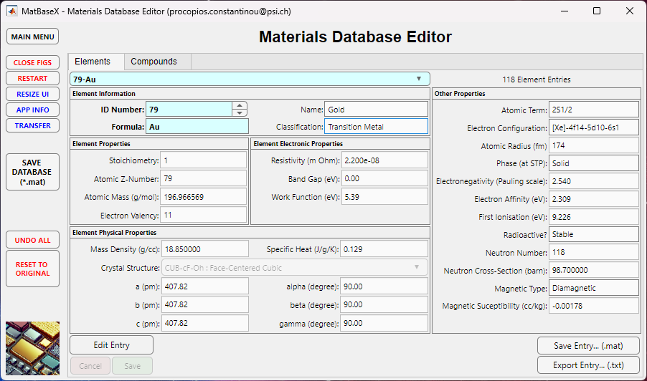
Currently 179 material entries.
Elements, Oxides, Binary Semiconductors & Ionic Salts Data.
Easily add new compound data. Options to modify, delete and export any element / compound properties data.

Slide 3
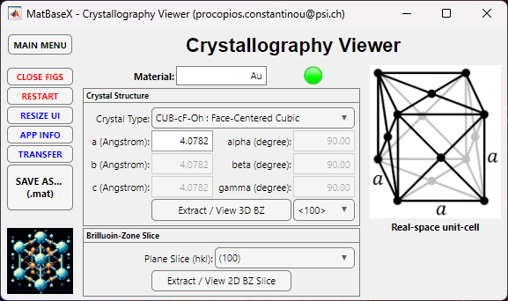
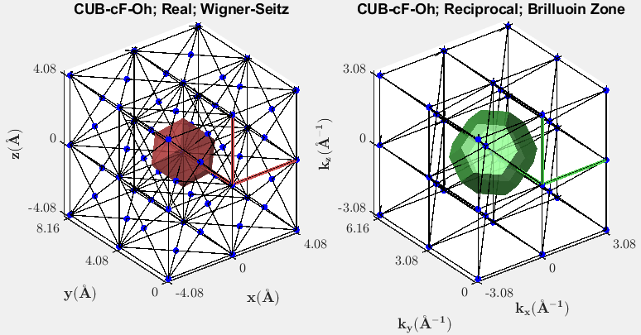
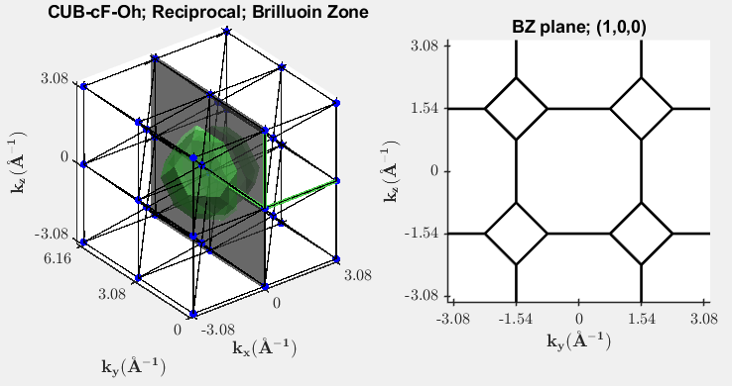
Access to all 179 material entries or manually enter the crystal-structure and lattice vectors.
Plot the 3D real- and reciprocal-space lattices.
Extract 2D slices through the Brillouin zone.

Slide 4
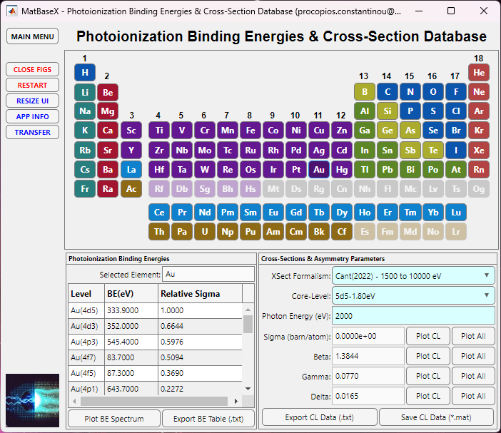
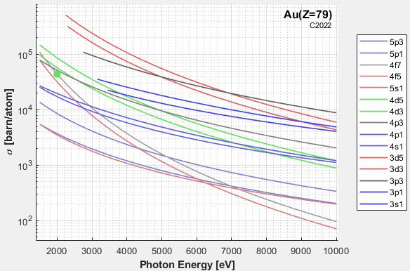
Sigma Cross-Sections
Element data 1 – 98 available.
Data from 4 different formalisms: Scofield (1973), Yeh & Lindau (1985), Trzhaskovskaya (2018) and Cant (2022).
Plot the binding energy spectrum, photoionization cross-sections, and photoionization asymmetry parameters.
Easily identify the optimal core-levels to probe by finding the maximum cross-sections for a given photon energy.
Save or export the binding energies or photoionization parameters as a text file.

Slide 5
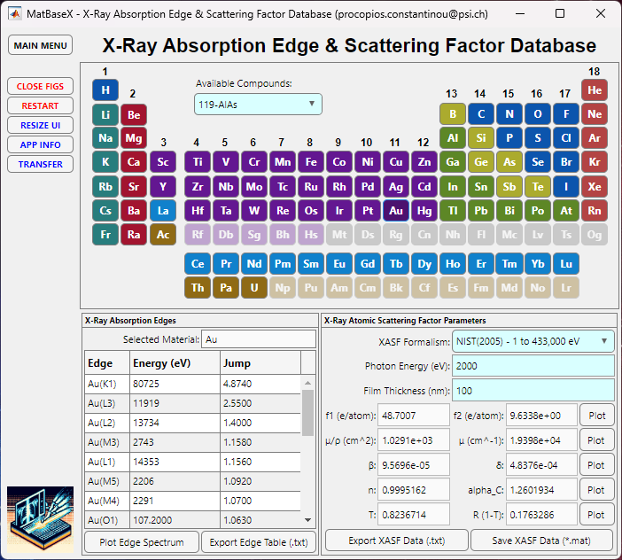
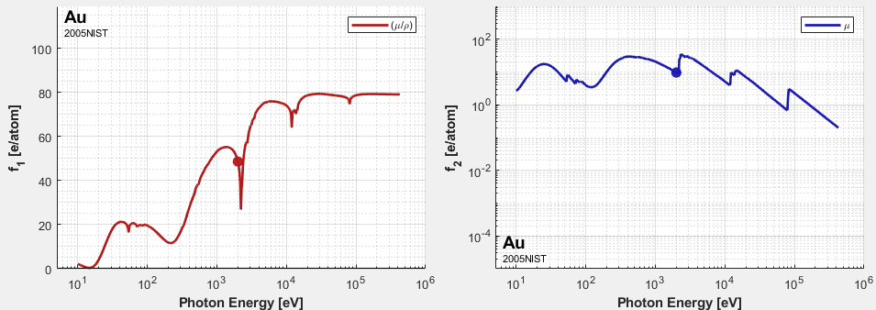
n
f1 vs photon energy
f2 vs photon energy
Element data 1 – 92 available.
Plot and calculate the absorption edge spectrum (from IXAS) and scattering factors (from Henke & NIST).
Calculate photoelectric mass attenuation coefficients, index of refraction, critical angle, transmission, and reflectance.
Easily identify the absorption edges for resonance spectroscopy.
Save or export the absorption edges or scattering factors as a text file.

Slide 6
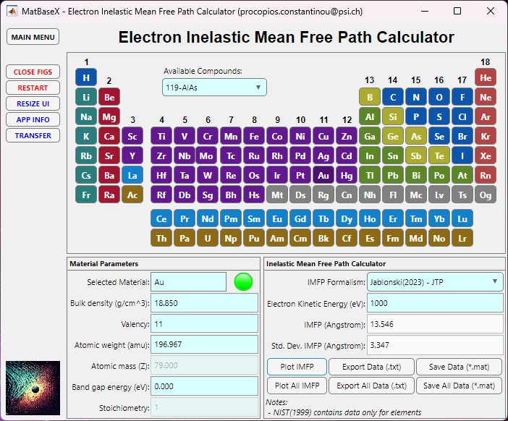
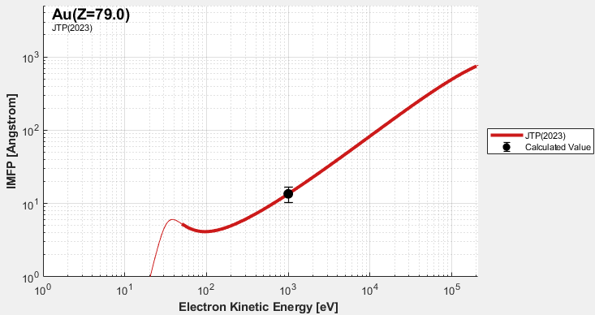
Plot of IMFP vs electron kinetic energy
Access to all 179 material entries or manually enter data for materials not included.
Plot and calculate the IMFP using a range of formalisms; Universal, TPP-2M, NIST, S1, S2, S3, S4 & JTP methods.
Estimate standard deviation across all the different formalisms for uncertainty quantification.
Plot, export or save IMFP data for future reference.

Slide 7
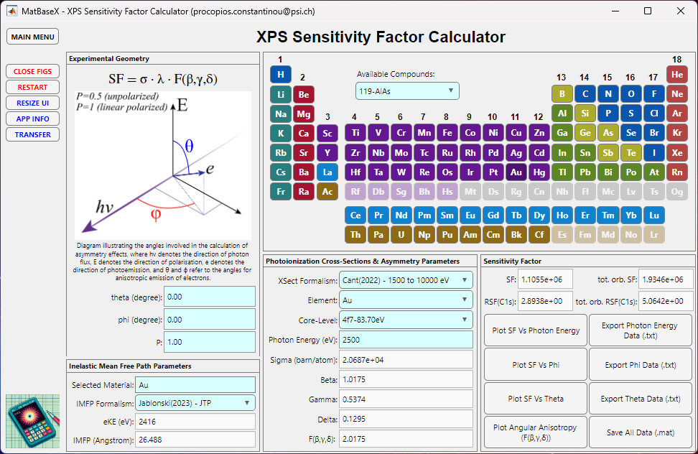
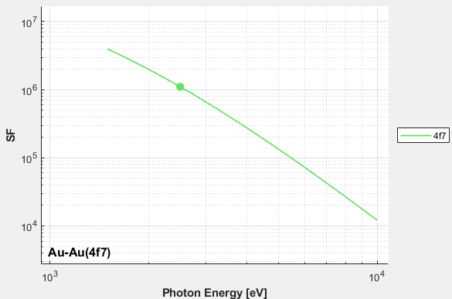
Plot of SF vs photon energy
Access to all 179 material entries.
Define your experiment setup and use the IMFP & Photoionization parameters databases to calculate the XPS sensitivity factor
Extract the Sensitivity Factor (SF) for PES quantification
Export the SF data as a text file.

Slide 8
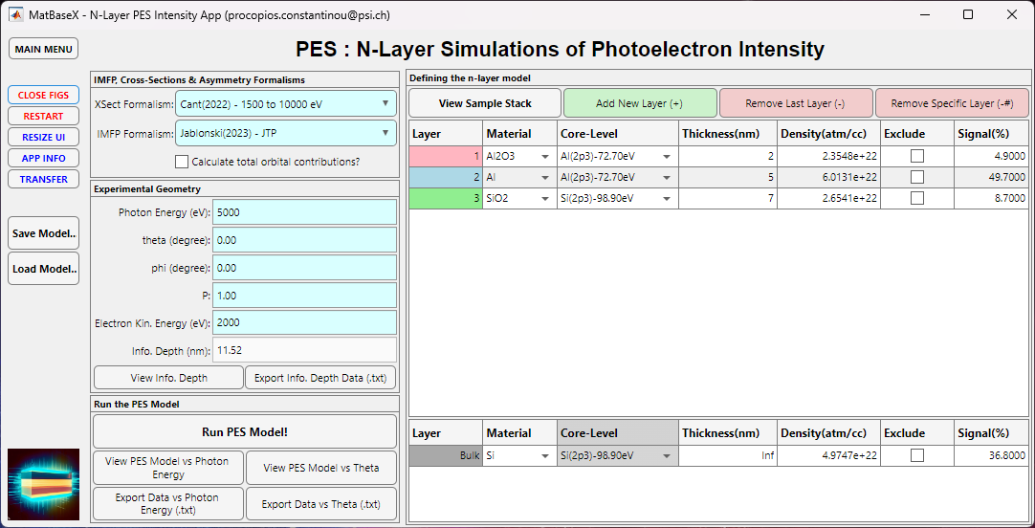
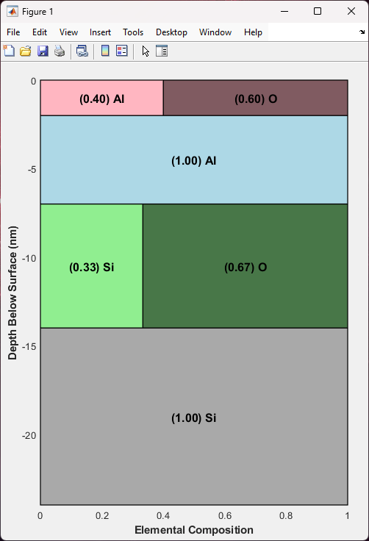
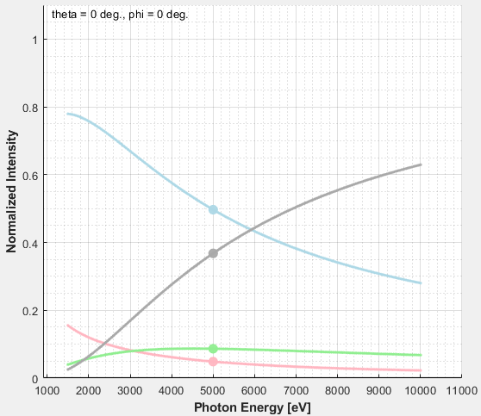
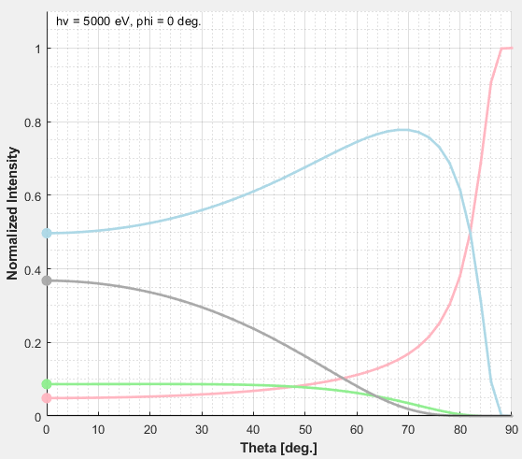
Access to all 179 material entries.
Uses IMFP, photoionization cross-sections and asymmetry databases.
Customize experimental geometry and photon polarization.
Select core-levels and generate sensitivity factor plots against photon energy and emission angle with a single click.
Save your models, which can be easily reloaded back into the App.
Export your model data as .txt files for external use.
n
Photon Energy Dependence
Emission Angle Dependence

Slide 9
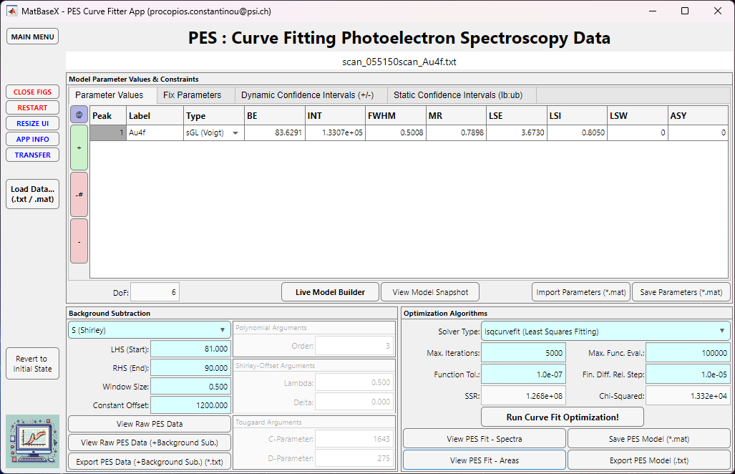
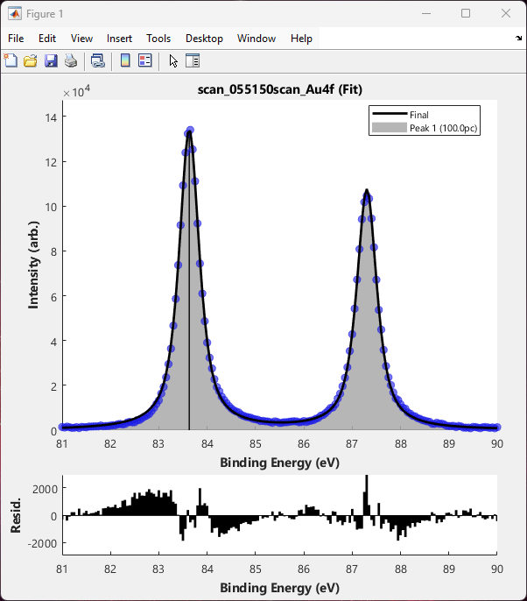
Fit to Au4f
Dedicated UI for curve fitting XPS data with up to 10 curve components.
Background Subtraction: Linear, Shirley, Shirley-Offset, Shirley-Smart and Tougaard.
PES curves: Gaussian, Lorentzian, Voigt, asymmetrical Voigt and Doniach-Sunjic.
Define an initial PES model and run an optimisation procedure to home into the best fit solution.
Export or save your fits, which can be easily reloaded back into the App for future reference.

